Slide 1
THE CLASSIFICATION OF MUTUAL EXCLUSION ALGORITHMS

Slide 2
Classification Requirements
Mutual exclusions tend to differ in their communication topology.
These algorithms can be grouped into two classes
The algorithms in the first class are non token based.
These algorithms require two or more successive rounds of message exchange among sites.
These algorithms are assertion based because a site can enter its critical section (CS) when an assertion defined on its local variable becomes true.Mutual exclusion is enforced because the assertion becomes true only at one site at any given time.

Slide 3
PRELIMINARIES
At any instant, a site may have several requests for CS.
A site queues up these requests and serves them one at a time.
A site can be in one of the following three states
Requesting CS,Executing CS or neither requesting or executing CS.
In a token based algorithms,a site can also be in a state where the site holding the token is executing outside the CS.Such a state is refered to as an idle token state.

Slide 4
Requirements of Mutual Exclusion Algorithm
Freedom from deadlocks
Freedom from starvation
Fairness
Fault Tolerance.

Slide 5
How to measure performance
1.Number of messages necessary per CS invocation
2.Synchronization Delay.
3.Response Time.
4.System throughput
System throughput=1/(sd+E)
sd=Synchronization delay.
E-average critical section execution time

Slide 6
Low and High load Performance
Best and Worst Case Performance

Slide 7
Lamport’s Algorithm
Lamport’s Distributed Mutual Exclusion Algorithm is a permission based algorithm proposed by Lamport as an illustration of his synchronization scheme for distributed systems. In permission based timestamp is used to order critical section requests and to resolve any conflict between requests.
In Lamport’s Algorithm critical section requests are executed in the increasing order of timestamps i.e a request with smaller timestamp will be given permission to execute critical section first than a request with larger timestamp.
In this algorithm:

Slide 8
Three type of messages ( REQUEST, REPLY and RELEASE) are used and communication channels are assumed to follow FIFO order.
A site send a REQUEST message to all other site to get their permission to enter critical section.
A site send a REPLY message to requesting site to give its permission to enter the critical section.
A site send a RELEASE message to all other site upon exiting the critical section.
Every site S_{i}, keeps a queue to store critical section requests ordered by their timestamps. request_queue_{i} denotes the queue of site S_{i}
A timestamp is given to each critical section request using Lamport’s logical clock.
Timestamp is used to determine priority of critical section requests. Smaller timestamp gets high priority over larger timestamp. The execution of critical section request is always in the order of their timestamp.

Slide 9
Algorithm:
To enter Critical section:
When a site S_{i} wants to enter the critical section, it sends a request message Request(ts_{i}, i) to all other sites and places the request on request_queue_{i}. Here, Ts_{i} denotes the timestamp of Site S_{i}
When a site S_{j} receives the request message REQUEST(ts_{i}, i) from site S_{i}, it returns a timestamped REPLY message to site S_{i} and places the request of site S_{i} on request_queue_{j}.
To execute the critical section:
A site S_{i} can enter the critical section if it has received the message with timestamp larger than (ts_{i}, i) from all other sites and its own request is at the top of request_queue_{i.}
To release the critical section:
When a site S_{i} exits the critical section, it removes its own request from the top of its request queue and sends a timestamped RELEASE message to all other sites
When a site S_{j} receives the timestamped RELEASE message from site S_{i}, it removes the request of S_{i} from its request queue

Slide 10
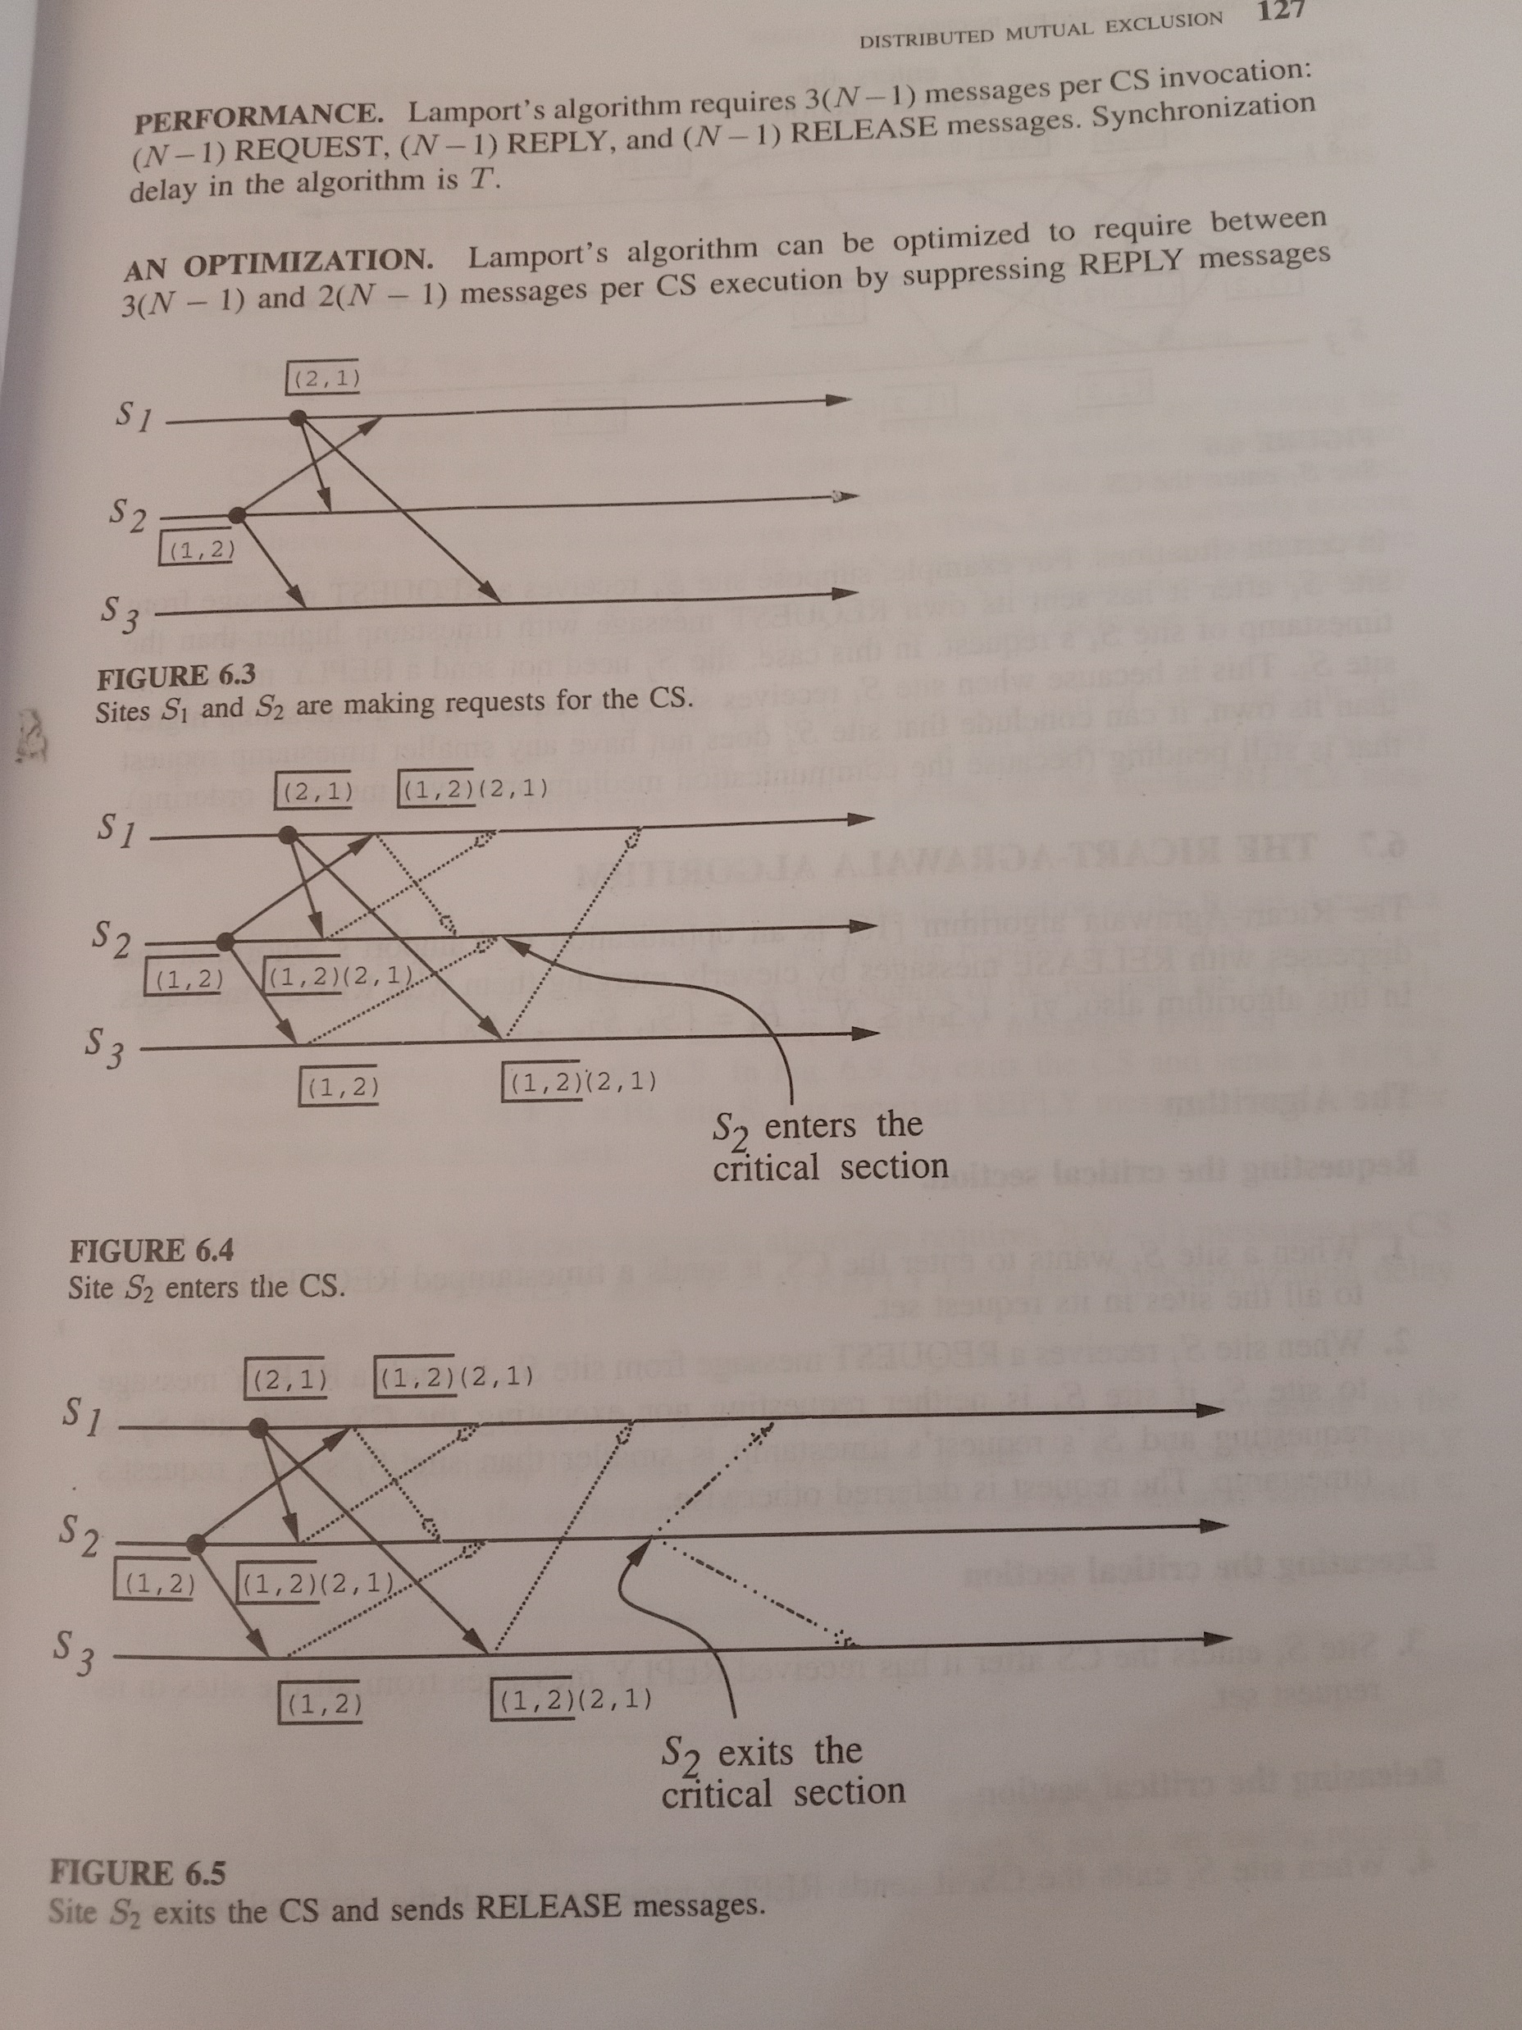

Slide 11
